Slide 1
Networking for systems engineers
A practical view to network engineering.

Slide 2
Computer networks, why are they cool?.
They are used for:
  Powering 2.5 million emails every SECOND. Yes, just by the time you finished this, 10 million emails have been processed.
  By the time this talk ends, google will have processed 499.998 Gigabytes of data, obnoxious way of saying 499.99 Terabytes or 0.49999 Petabytes.
  In exactly 29 minutes, You Tube will have 10 more hours of video.
  Instead of getting mad at your ISP, you’ll know what they messed up to kill your network.
  Today I tinkered with the company’s network in order to affect the Sophilabs website, and some other easter eggs. Among them, to gain traffic to a website.

Slide 3
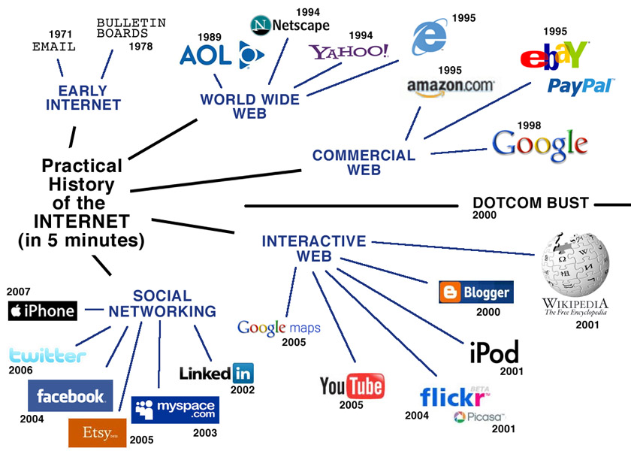
So what?
We were too young for this stuff.
LOL No one cares!.

Slide 4

What do we use them for?

Slide 5
Types - Definitions:
WAN (Wide Area Network)
  Normally this is described as “The interwebsnet”.
  Normally is the part you pay for.
  Normally it’s your most generic route in your pc.
  Also used to hide inter-networks we don’t care how that’s connected.
LAN (Local Area Network)
  Normally you don’t pay for it.
  Normally exposes more threats to the WAN.
  Normally is where your computer is connected.
  Should be private.
MAN (Metropolitan Area Network)
  In Uruguay we don’t really have this, but could be a network defined by a company or by your ISP.

Slide 6
Okay, so… I plugged the cord, what happens now?.
You’ll need something more than your computers MAC address (Unique between network cards) .
Now your computer will try to acquire an IP address if you didn’t set one yourself as static.
Your gateway will should give you an unused leased IP, normally will try to keep the same, as long as this is possible.
You will receive more than that, you’ll get your DNS, Gateway, NTP, WINS…
Congratulations, now you’re connected to the internet!.
    Hold on… You just skipped the whole presentation.
      Shh…

Slide 7
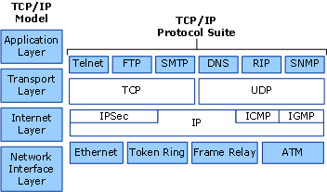
TCP/IP Protocol.
Probably 80% or more of what
We do, is on this layer.

Slide 8

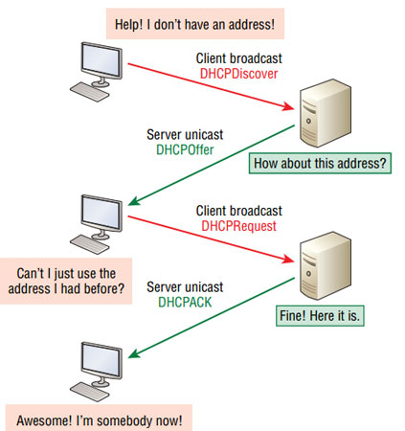
How do I get my IP?
Dynamic Host Configuration Protocol (DHCP) is a client/server protocol that automatically provides an Internet Protocol (IP) host with its IP address and other related configuration information such as the subnet mask and default gateway.
We use something called DORA [discovery, offer, request, acknowledge].
  Discovery is made through IP 255.255.255.255 [Broadcast IP address for the network].
  Gateway replies, here, have x.x.x.x, do you take it?
    If taken, machine is now configured. And you reply “Acknowledge” –ack.
What’s next?!

Slide 9
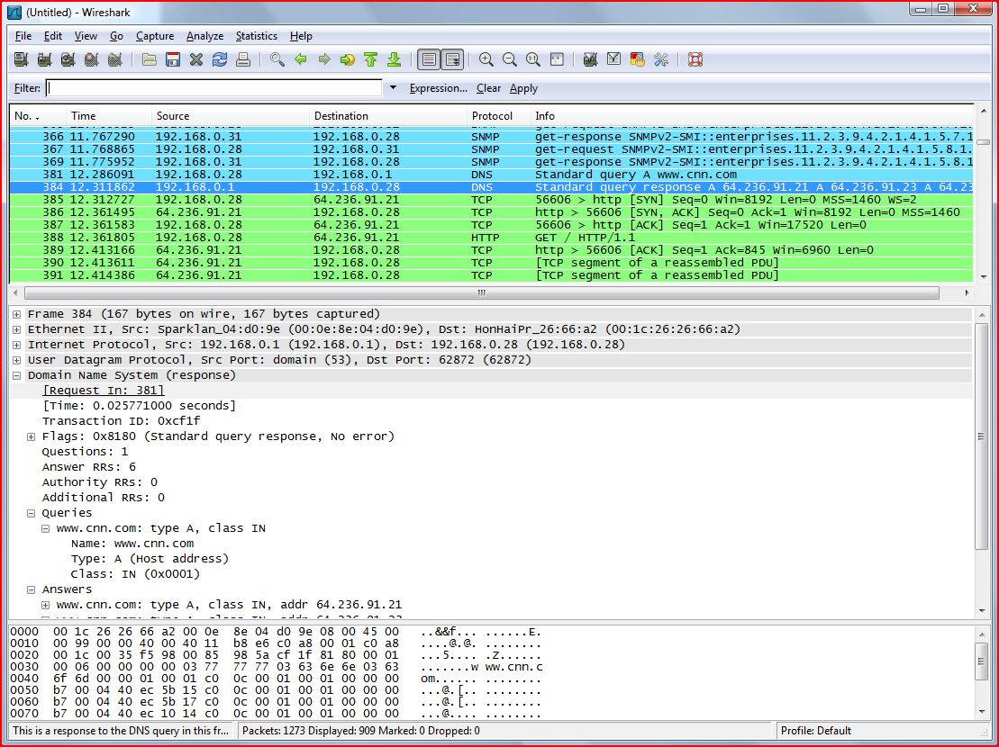
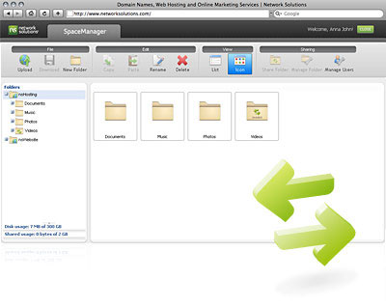
Now we have a Local IP…
Having a local IP now allows us at least to access other machines within the network, and well… allows us to do something like this.

Slide 10
Lets assume you now want to access the internet…
Physical:
  A modem, or Uplink to get a connection that’s generally available.
  The connection between you, and your modem or uplink.
Logical:
  DHCP should have pushed the gateway as the most generic route.
  The generic route should have a low metric.

Slide 11
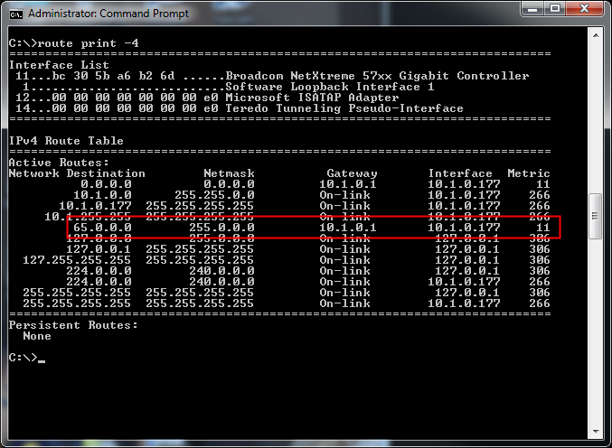
Routing
Lowest metric network.
Most generic destination.

Slide 12
Awesome, we know where to go… if its out of our network.
To figure out how to get to a website like CNN.com the computer follows some steps.
Get the URL you’re trying to go to.
Request the machine’s DNS (Domain Name Service) resolver to solve cnn.com – IP address.
The request is sent to the DNS server, the server forwards our query and cache’s the result for as long as the TTL is set.
The computer saves the response to avoid asking over, and over again.
And sends a TCP packet on port 80 to the IP CNN resolved to.

Slide 13
Gateway receives the packet, now?.
Reads the TCP packet transport layer, and sees where he has to send the packet.
For the purpose of this talk, we’ll assume our ISP is just another router, and he represents the whole internet.
The packet is read, we see the destination is not us, meaning we’re just a hop, so we send that packet to our closest router (WAN) to be forwarded and processed by the next router.
A ton of technologies exist on routing to define the path the packet will take to get to the destination server…. But there’s a way we can see that path and it’s with a tool like MTR – TraceRoute.
Let’s do “mtr cnn.com”

Slide 14
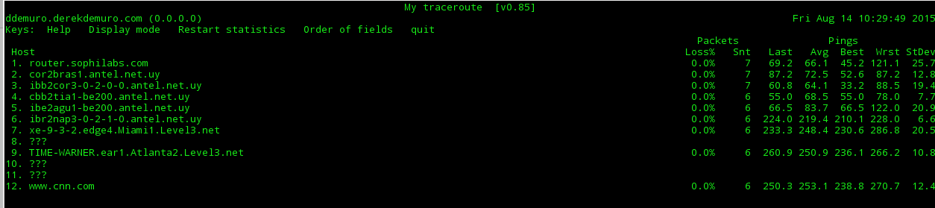
MTR - TraceRoute
MTR is a TraceRoute mixed with a ping, so we get the latency and hops to every step our packet will make to get to the remote endpoint.

Slide 15
What are those hops?
Performing some simplification, those hops are routers.
Even sophie’s router is there.
Okay so far that was static routing, is there anything else?
Yes other protocols are involved with their own purposes…
  BGP (Border Gateway Protocol)
  OSPF (Open Shortest Path First)
Aren’t you forgetting one?... Microsofts.
  RIP
  RIP v2
    ???

Slide 16
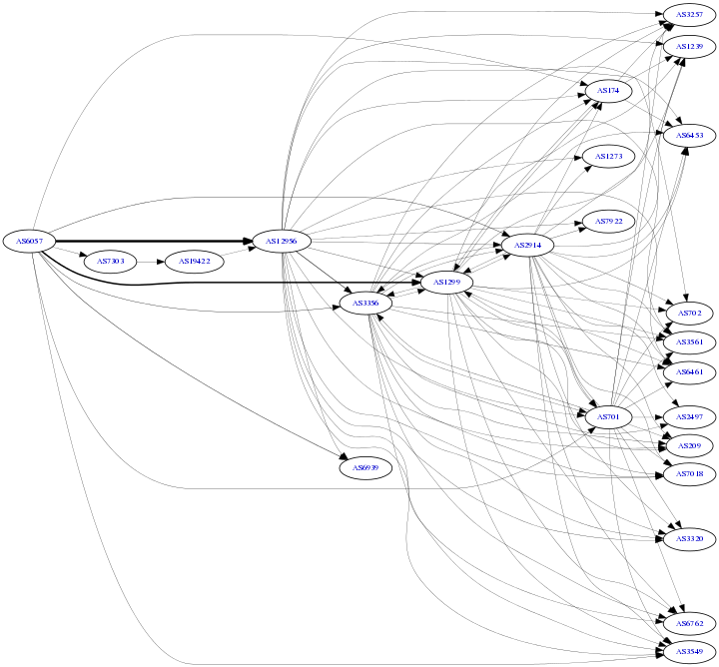
As any network, your ISP has other connections.
Something like this… all those balloons are networks, and all those arrows are BGP routes.
This are defined as autonomous systems, and that means that one only knows who each of them is connected to.
When you route, they re-route you.
When a network is down, this guys take the bullet.
This is why you normally pay for to your ISP… because they use this guys as what’s defined as “Transport”.

Slide 17
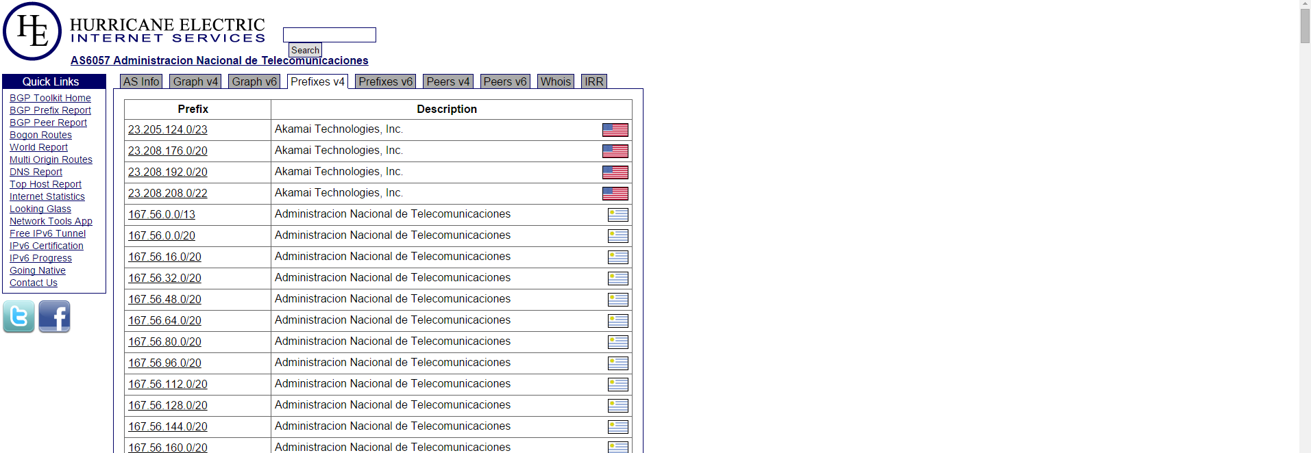
Uruguay is connected… quite enough.

Slide 18
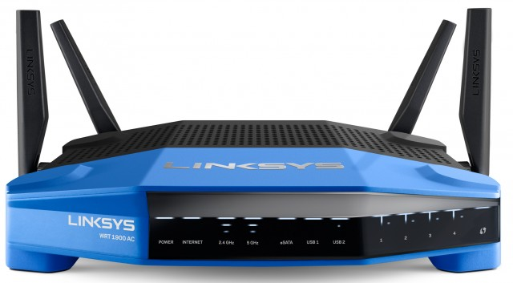
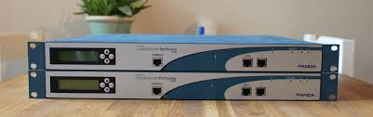
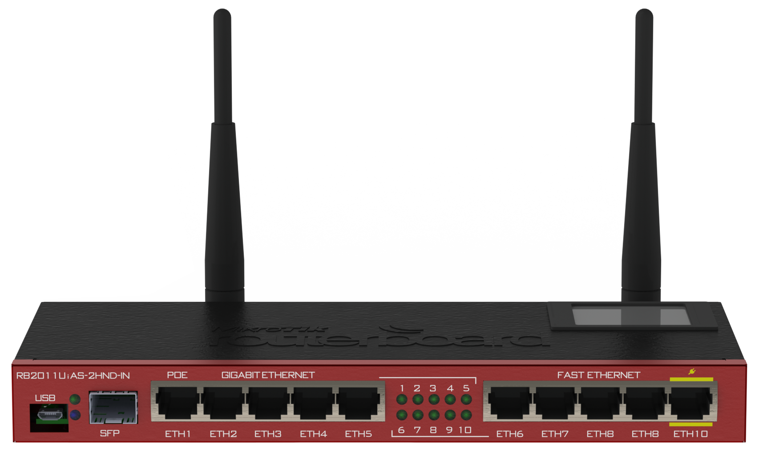
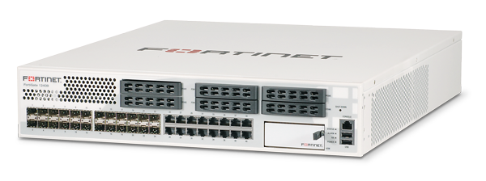
Okay so now we’re routed. Why choose a better router.

Slide 19
Features. It’s always features, and hardware.
Routing needs a routing table.
Needs memory, and buffers.
Processing power.
Good network cards.
Why that, all they do is forward packages?…
And here’s my example.

Slide 20
Custom Hardware
You can add RAM, CPU, Network cards, etc.
Can hold up to 302000 connection tables, and it’s state.
Has a dynamic buffer at a default of 26584 Bytes.
Does:
  Traffic Shaping
  DNS Server
  DHCP Server
  Proxy – Cache.
  Network Diagnostics…………………..

Slide 21
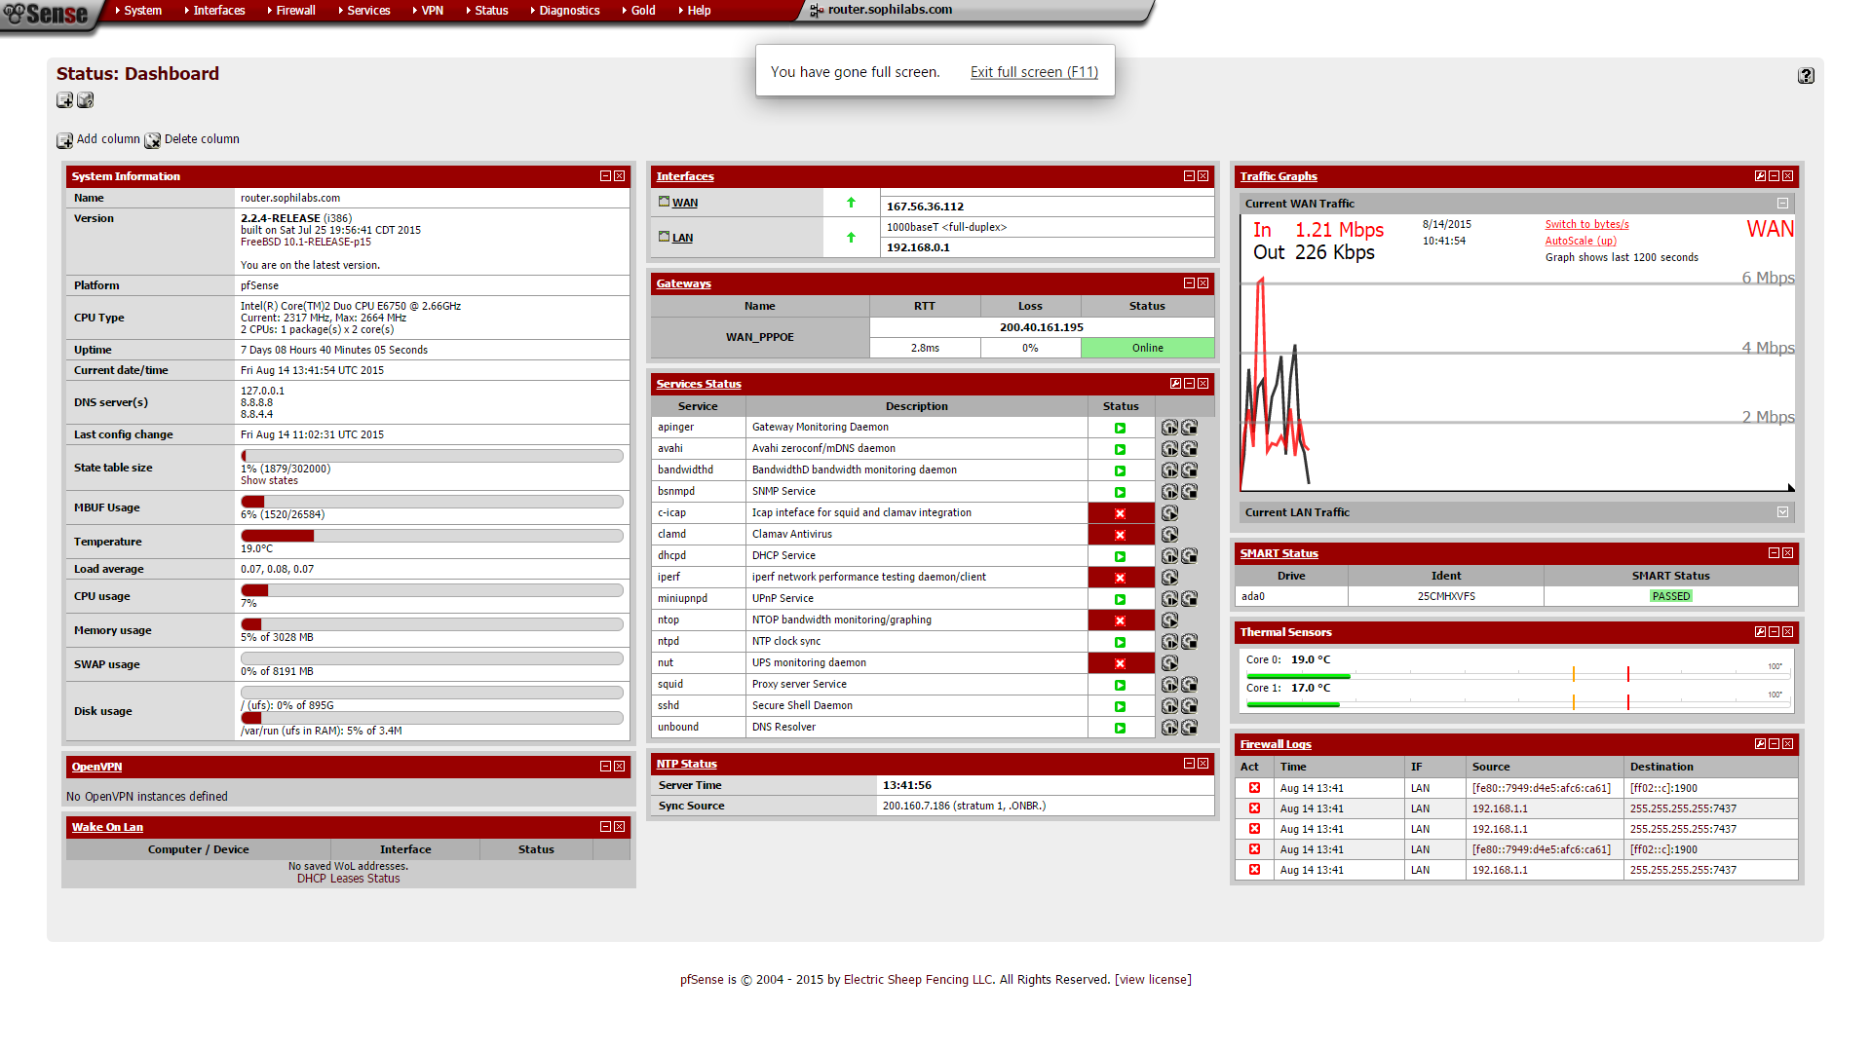
Interface

Slide 22
Home Routers
Normally you can’t change even the antennas.
Normally have a tiny state table size.
Normally buffers are limited.
Normally doesn’t support many features like full traffic shaping.
Normally doesn’t have advanced protocol support.

Slide 23
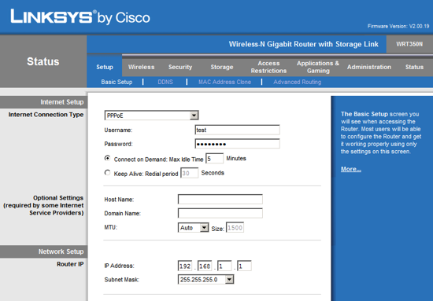
Linksys Example:

Slide 24
To sum up.
It should always be taken into account not only the network, but how many clients will connect. [Small state table = dropped connections].
Buffers are used… A LOT, having plenty of space in them, will guarantee packets will arrive.
If a smart traffic shaping is applied, both of the above will be even more important, since most protocols will use them, and assume they can use them.
Advanced firewall features, may save time, money, and bandwidth.
Its just worth spending the extra cash into having a decent network.

Slide 25
Traffic Shaping - Types
[PRIQ] Priority Queuing: Priority queuing is the simplest form of traffic shaping, and often the most effective. It performs prioritzation of traffic only, without regard for bandwidth. A flat hierarchy of priority levels is created, all packets at the highest priority level are always processed first.
[CBQ] Class Based Queuing: is the next step up from priority queuing. A tree hierarchy of classes is created; each with an assigned priority and bandwidth limit. Priority works much in the same way that it does in the PRIQ however, instead of processing all packets from the class, it will only process enough packets until the bandwidth limit is reached.
Hierarchical Fair Service Curve (HFSC) is the most complex of the ALTQ shaper types.. It has a heirarchy of queues and is capable of real-time traffic guarantees.
It can be very effective for VoIP on links that degrade quickly, such as 3G/4G, but it can be complex to configure and tweak for proper operation.

Slide 26
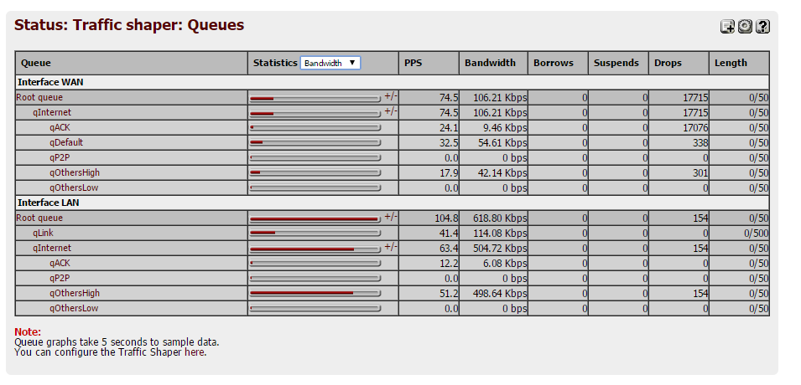
Example of HSFC here in Sophie.
Traffic shaping in action.
The traffic is categorized, and will
use it’s defined queue rules.
If qP2P needs bandwidth, and
there’s a free queue, it can “borrow”
the corresponding slot to use himself.

Slide 27
Wireless
So far, it will Always be slower than wired networks.
It will have a bigger latency.
It will hold ~10 users per access point unless its enterprise grade.
Today its better to get a 5 GHz router.
The latest standard is Wireless AC, N is already old.
It’s worth getting MIMO [Multiple Transmitters Receivers]
It’s half duplex.
It’s somewhat reliable.

Slide 28
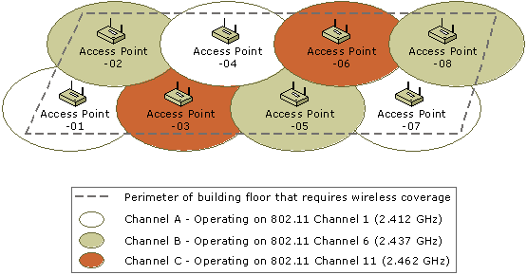
Wireless Overlapping – Worst thing ever.
Since, wireless overlapping has an effect like running a high voltage power line close to a wired network (adds jitter)… should be avoided at all costs.
I used this example as how to plan a Wifi deployment plan. Just like we have at Sophie.
If multiple AP’s are deployed, remember to low-power them…

Slide 29
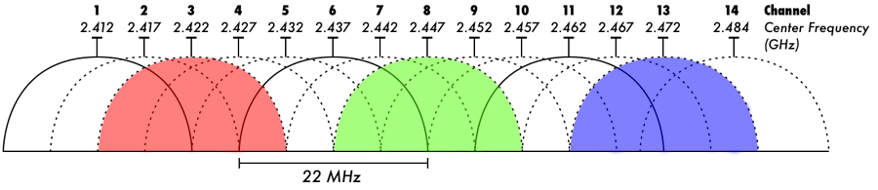
Wireless Overlapping – Channels.
When choosing channels you should take into account other networks, not controlled by you.
Following the diagram you’ll know how to set your access points in order to avoid collisions.
Avoid having high power Wi-Fi for no reason.

Slide 30
Finally… just for fun.
Some DNS poisoning.
DNS poisoning is, retuning to a client a modified DNS query.
This is normally how a network is infected, and how phishing happens.
This could be an infected server, or your machine… using your hosts file configuration.
Is common for pranks, and driving users nuts.
It’s common to make someone believe they are talking to a server, when in fact they are talking to someone else.
Will probably break SSL, unless we use some MITIM (Man in the Middle)

Slide 31
Thank you, next is the full blown internet.
Now you know the basics of networking in a practical way…
Just remember, the internet is not a magical place… and the same that applies to your home network applies to your ISP… the only difference is the scale.

